Slide 1
COMP1003 – Algorithms, Data Structures & Maths Session 09 Formal Languages and Automata
Thomas Wennekers
University of Plymouth

Slide 2
Main Ideas
Pattern matching is central to many applications and supported by regular expressions in programming languages
The Chomsky hierarchy of Formal languages provides a theory of programming languages of increasing expressivity (i.e. power)
Formal Automata or Machines are models of computation. They implement languages of the Chomsky hierarchy
Notes:
2

Slide 3
Aims and Objectives
Understand the basics of
Regular Expressions
Regular and Context-free Languages
Finite State and Pushdown Automata
Notes:
3

Slide 4
Why Learn Theory?
... for the fun of it
gain a deeper understanding of what a computer is and what can be computed
philosophical implications, e.g.
can computers become smarter than us?
not every problem that can be formalised can be solved
fomal languages and automata are at the foundation of all modern computers
Notes:
4

Slide 5
Why Learn Theory?
... for its practical implications
Web (and other) search: theory of pattern matching, e.g. using Regular Expressions
Sequential circuits (e.g. in CPU cores): theory of finite state automata
Compilers: theory of context-free grammars
Cryptography: theory of computational complexity
….
Notes:
5

Slide 6
Outline
Regular Expressions
Finite State Automata
Formal Grammars
Regular & Context-free Languages
Pushdown Automata
Further Comments
Summary
Notes:
6
DO go briefly through this

Slide 7
Regular Expressions
a(a|b)*
Notes:
7

Slide 8
RegExps describe Patterns
Pattern matching applications
search for information at google, in data bases, texts, documents, or libraries
process programming or natural languages
spam-filter emails and other files
validate data-entry fields
...
Notes:
8

Slide 9
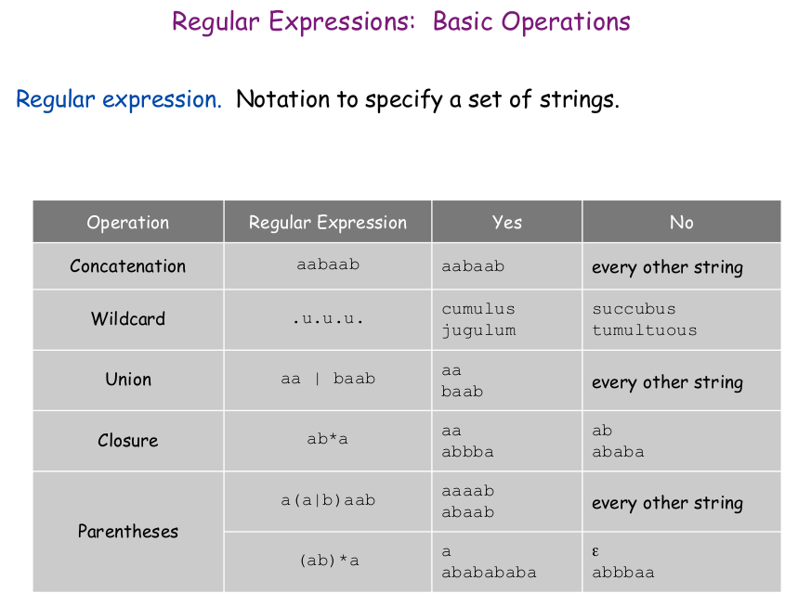
usually infinite
Notes:
9

Slide 10
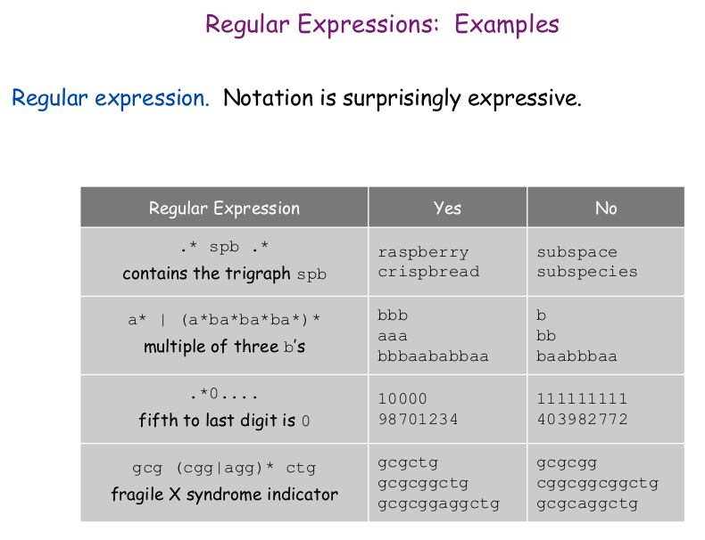
Notes:
10
ditch this in first run because I thought I'd be runing short – should rather explain it

Slide 11
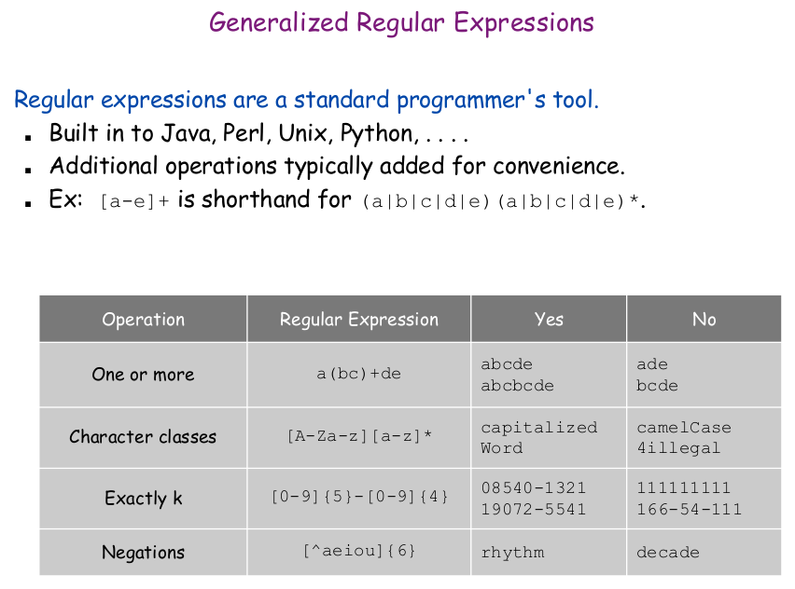
Notes:
11

Slide 12
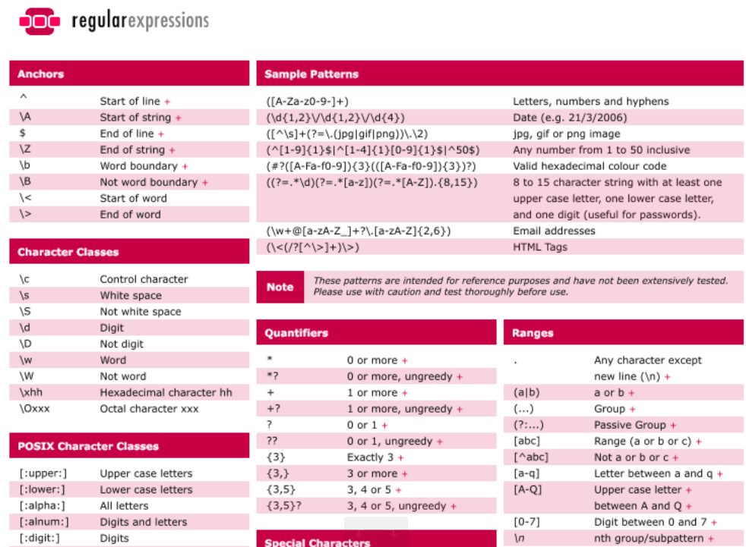
A RegExp cheat sheet is online
('+' rules can be found in most implementations)
Notes:
12

Slide 13
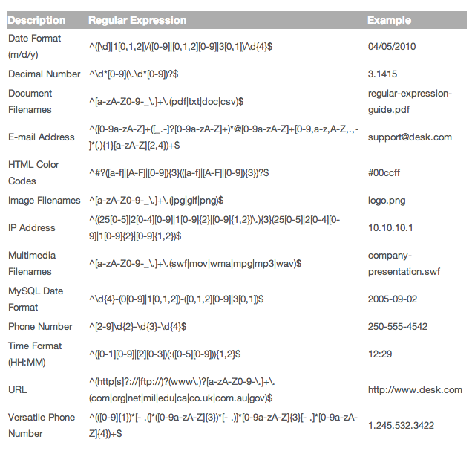
More Examples
Extended RegExps are not relevant for the assessment on this module, but useful to learn anyway.
Notes:
13

Slide 14
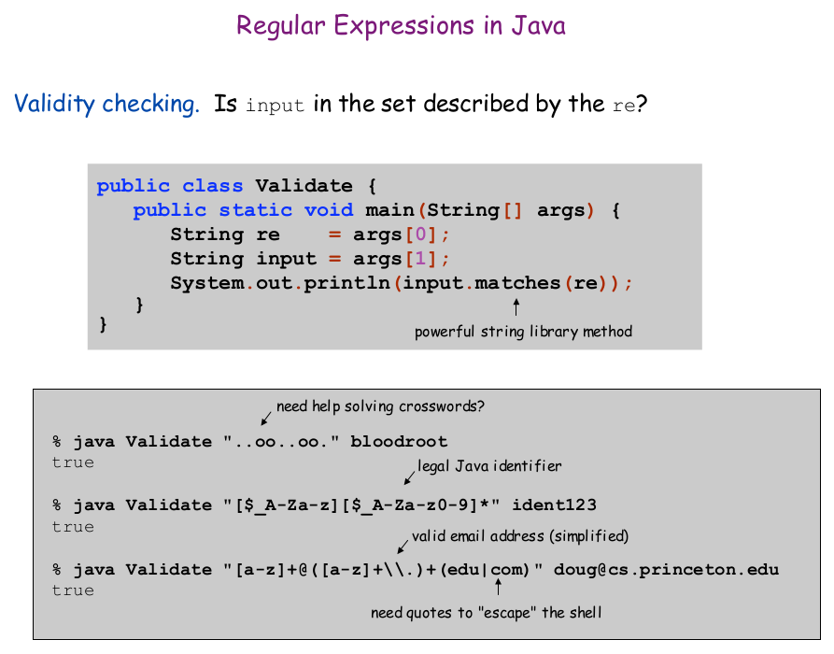
Example of how simple regExps are to use in Java
This is again not directly assessment relevant; in fact: don't use any library regExp methods in assessment elements
Notes:
14

Slide 15
a(a|b)* = ??
Notes:
15

Slide 16
a(a|b)*
=
The set of all strings of a's and b's
that start with at least one a
Notes:
16

Slide 17
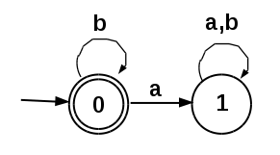
Finite State Automata
Notes:
17

Slide 18
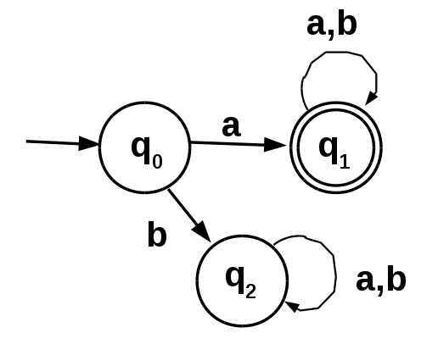
Deterministic Finite State Automata informal explanation
This DFA has three states q₀, q₁, q₂
Notes:
18
correct the two errors

Slide 19
Deterministic Finite State Automata informal explanation
It reads input symbols, a's or b's, and transits between states as indicated by the labelled arrows
Notes:
19

Slide 20
Deterministic Finite State Automata informal explanation
start
q₀ is the start state, indicated by the ingoing unlabelled arrow on the left. There can only be one start state in a DFA.
Notes:
20

Slide 21
Deterministic Finite State Automata informal explanation
accepting state
q₁ is an accepting state, indicated by the double circle. If an accepting state is reached after all input has been read, the string is correct or accepted. There can be more than one accepting state.
Notes:
21

Slide 22
Deterministic Finite State Automata Example Operation
“a” is correct
“aaaaa” is correct
“baaba” is incorrect (as is just “b”)
Notes:
22

Slide 23
Example 2
Which regular expression does this DFA compute?
Notes:
23

Slide 24
... all strings of a's and b's that contain a non-negative finite number of b's only, i.e., b*
Notes:
24

Slide 25
Formal Definition of DFAs
A Deterministic Finite State Automaton M is
a 5-tuple M = ( Q, Σ, q₀, F , δ ) where
Q is a finite set of states
Σ is a finite set of input symbols (“alphabet”)
q₀ is a start state from Q
F is a set of accepting (or final) states from Q
δ is a transition function,
i.e. a total mapping from Q x Σ to Q
Notes:
25

Slide 26

Comments: Transition Function
The transition function δ takes a state q and an input symbol a and maps them to a state q'
The function is “total”: for each pair (q,a) exactly one target state q must exist: δ(q,a) = q'
One often writes for δ(q, a) = q'
δ can be represented by a matrix T in code
Notes:
26

Slide 27
Example of what the Symbols mean
Q = {0,1}
Σ = {a, b}
q₀ = 0
F = {0}
Notes:
27

Slide 28
Example of what the Symbols mean
Q = {0,1} δ(0,a) = 1 ; δ(0,b) = 0
Σ = {a, b} δ(1,a) = 1 ; δ(1,b) = 1
q₀ = 0
F = {0}
Notes:
28

Slide 29
Example of what the Symbols mean
Q = {0,1} δ(0,a) = 1 ; δ(0,b) = 0
Σ = {a, b} δ(1,a) = 1 ; δ(1,b) = 1
q₀ = 0 Array representation of δ
F = {0} T = [ 1, 0
1, 1 ]
Notes:
29

Slide 30

How a DFA works
A run of a DFA M on s = a₀, a₁, .. a_{n-1} is a sequence of states q₀,q₁,q₂,..q_{n} such that for all
Determinism: for a given input word a DFA has a unique run, because the transition function is a total function
The DFA accepts a word if q_{n} is in the set of final states F; otherwise it rejects the word
Notes:
30

Slide 31
DFA Implementation ?
Build an algorithm that checks if a string is accepted by a DFA
Notes:
31

Slide 32
Informal Solution
store input as an array of symbols 'a' of size n
store the transition table as a 2D-array T
start with state q in q₀
iterate through the input and update the state
in step i: q := T [ q, a[i] ]
if after the loop, q is in the array F of final states the input is accepted, else rejected
Notes:
32

Slide 33
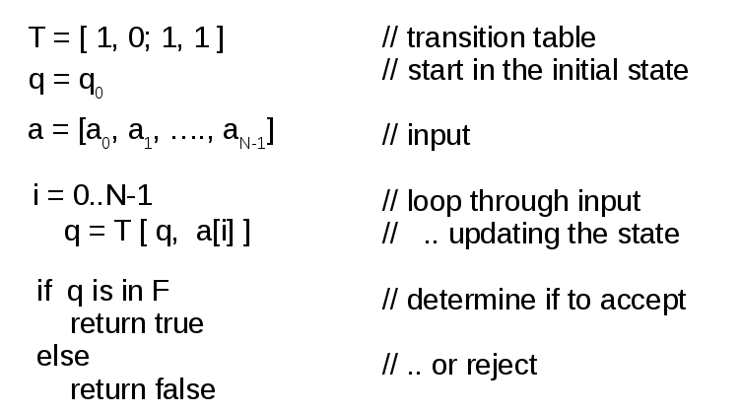
Pseudocode
Notes:
33

Slide 34
Non-Determinism
In a DFA, each pair of state and input symbol uniquely defines a next state
Non-determinism allows for missing and non-unique transitions (and possibly for more than 1 start state)
Notes:
34

Slide 35
Non-Determinism
In a DFA, each pair of state and input symbol uniquely defines a next state
Non-determinism allows for missing and non-unique transitions (and possibly for more than 1 start state)
If multiple targets exist (non-determinism!) the machine is “cloned” and all alternatives run further
There may be “epsilon-transitions” (without an input)
Notes:
35

Slide 36
Non-Determinism
In a DFA, each pair of state and input symbol uniquely defines a next state
Non-determinism allows for missing and non-unique transitions (and possibly for more than 1 start state)
If multiple targets exist (non-determinism!) the machine is “cloned” and all alternatives run further
There may be “epsilon-transitions” (without an input)
If a target state cannot be determined the machine dies
A word is accepted if at least one derivation exists, i.e. if at least one machine survives in an accepting state
Notes:
36

Slide 37
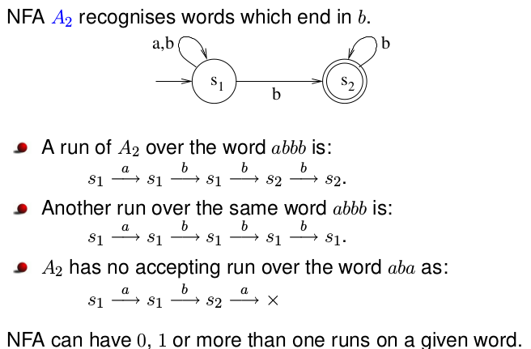
Nondeterministic FSA Example
Notes:
37
I was somehwat swimming here

Slide 38
Automata correspond with “Languages”
Notes:
38

Slide 39
Formal Languages
Finite state machines accept or reject words
The set of all words an FSA called A accepts is called the Language it accepts
Regular Expressions characterise words as well, thereby they also define Languages
Notes:
39

Slide 40
Equivalences (without proofs)
For each DFA exists a regular expression that defines the same Language as the DFA
For each regular expression exists a DFA that accepts the same language as the RegExp
Notes:
40

Slide 41
Equivalences (without proofs)
For each DFA exists a regular expression that defines the same Language as the DFA
For each regular expression exists a DFA that accepts the same language as the RegExp
For each NFA exists a DFA that accepts the same language (i.e. NFAs are not stronger than DFAs)
Notes:
41

Slide 42
Equivalences (without proofs)
For each DFA exists a regular expression that defines the same Language as the DFA
For each regular expression exists a DFA that accepts the same language as the RegExp
For each NFA exists a DFA that accepts the same language (i.e. NFAs are not stronger than DFAs)
DFAs, NFAs, and regular expressions all compute the same class of languages
These are the regular languages
Notes:
42

Slide 43
Grammars and Languages
or
A grammatical approach towards languages
Notes:
43

Slide 44
A simple “Formal Language” expressed by a generative grammar
S ::= NP VP “.” ; CAPITALS are Syntactic Variables
“text” are Terminal Symbols
NP ::= DET NOUN | NAME ; ::= means “is defined as”
“|” denotes alternative choices
DET ::= "a" | "an" | "the" ; “;” means “end of rule”
NOUN ::= "dog" | "house" | "pen" | "animal" ;
NAME ::= "John" | "Mary" | "Bob" ;
VP ::= "sleeps" | "sings" | "is" ADJ | “is” NP | "has" NP ;
ADJ ::= "large" | "red" | "scary" ;
44
Notes:
44

Slide 45
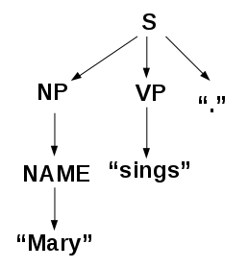
String Generation
To generate a string of the language, start at the start symbol S and recursively apply rules until a string is obtained that does not contain syntactic variables anymore.
Example
S → NP VP “.”
NP → NAME
NAME → “Mary”
VP → sings
Syntax tree of “Mary sings.”
45
Notes:
45
perhaps show the partially derived strings, not the rules in the lower left only

Slide 46
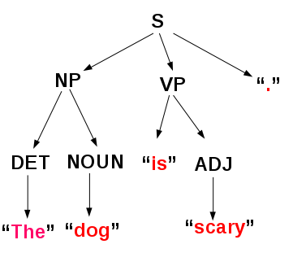
Another Example
S ::= NP VP “.” ;
NP ::= DET NOUN | NAME ;
DET ::= "a" | "an" | "the" ;
NOUN ::= "dog" | "house" | "pen" | "animal" ;
NAME ::= "John" | "Mary" | "Bob" ;
VP ::= "sleeps" | "sings" | "is" ADJ | “is” NP | "has" NP ;
ADJ ::= "large" | "red" | "scary" ;
46
Notes:
46

Slide 47
Formal Grammar&Language Definition
A Formal Grammar is a 4-tupel G=(V,Σ,P,S)
where
V is a finite set of (Syntactic) Variables
Σ is a finite set of Terminal Symbols disjoint with V
S is the Start Symbol
P is a finite set of Production Rules (see later)
The Formal Language defined by a grammar is the set of all strings that can be derived from S
47
Notes:
47

Slide 48
Regular Grammars
For “Regular Grammars” all productions are of one of these two forms:
A ::= “a” ; // A produces a terminal
A ::= “a” B ; // A produces a terminal followed
// by a syntactic variable
Notes:
48

Slide 49
Regular Grammars
For “Regular Grammars” all productions are of one of these two forms:
A ::= “a” ; // A produces a terminal
A ::= “a” B ; // A produces a terminal followed
// by a syntactic variable
“Typewriter grammar” because terminals are “printed” from the left to the right one by one
Notes:
49

Slide 50
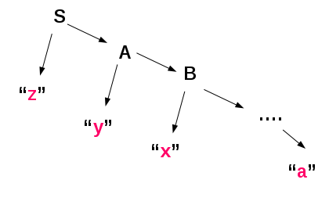
Regular Grammars
The syntax tree of productions is always degenerated
Production proceeds until a single terminal is derived
Notes:
50

Slide 51
Regular Grammars
The languages generated by Regular Grammars are exactly the same as those defined by regular expressions.
RegExps, DFAs, NFAs, and regular Grammars all generate or recognise exactly the Regular Languages
Notes:
51

Slide 52
Limits of Regular Languages
Consider L = { a^{n} b^{n} | n > 0 }
= { n a's followed by n b's }
= { ab, aabb, aaabbb, …. }
This can not be recognised by a DFA
for any finite n one could have a chain of 2n states, first for n a's and then n b's. However, there is always a larger n
This can also not be expressed by a RegExp
a*b* is perhaps the closest? But there is no “memory” for n
Notes:
52

Slide 53
Context-Free Grammars and Languages
For “Context-Free Grammars” productions can have an arbitrary but finite sequence of variables on the right hand side of any rule.
A ::= B “c” D “e” ;
However, the left hand side must always be a single variable (without “context” nearby)
Notes:
53

Slide 54
Context-Free Grammars Example 1 : Toy Language
The previous simple toy language is context-free
It's always single variables that get expanded
Therefore it's a tree!
Notes:
54

Slide 55
Context-Free Grammars Example 2 : a^{n}b^{n}
G = ( {S}, {a, b}, {S→ab, S→aSb}, S )
This Grammar generates { a^{n}b^{n} | N>0 }
S → aSb → aaSbb → aaaSbbb → aaaabbbb
Notes:
55

Slide 56
Context-Free Grammars Example 2 : a^{n}b^{n}
G = ( {S}, {a, b}, {S→ab, S→aSb}, S )
This Grammar generates { a^{n}b^{n} | N>0 }
S → aSb → aaSbb → aaaSbbb → aaaabbbb
→ CFLs are more powerful than Regular Languages
Notes:
56

Slide 57
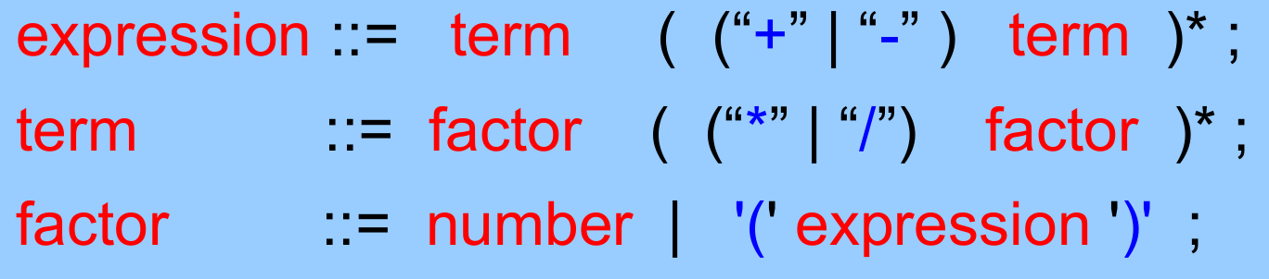
Context-Free Grammars Example 3 : C/C++/C#/Java ...
Most programming languages are formulated in Extended Backus Naur Forms (see SOFT153) which are equivalent to CFGs, e.g.
Notes:
57

Slide 58
Context-Free Grammars Example 3 : C/C++/C#/Java ...
Most programming languages are formulated in Extended Backus Naur Forms (see SOFT153) which are equivalent to CFGs, e.g.
However, some aspects of programming languages can not be expressed, e.g.
type compatibility or function argument lists
These constraints have to go separate of the EBNF specification; they are context-sensitive
Notes:
58

Slide 59
Pushdown Automata
How can CFLs be processed?
i.e. recognised
Notes:
59

Slide 60
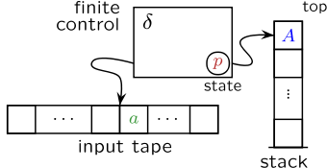
Pushdown Automaton
A pushdown automaton is basically a finite state automaton with an additional stack to store some information about the ongoing computation
Nothing else said, a PDA would use an NFA
Notes:
60

Slide 61
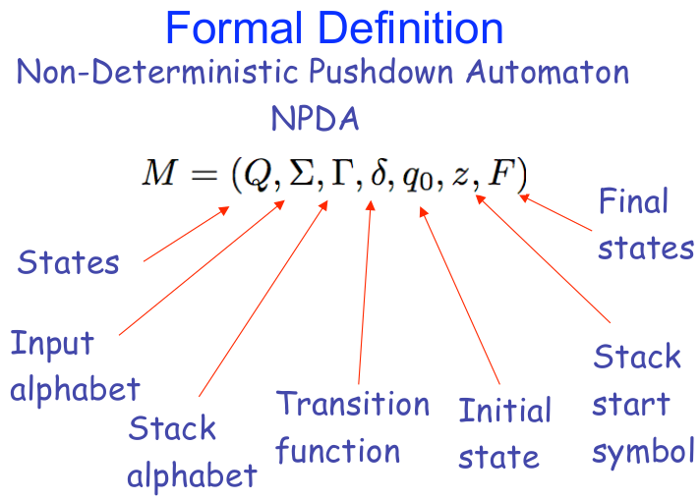
Notes:
61
Definition combines properties of the NFA and the stack; both join in the definition of delta
Stack start symbol == bottom of stack
different definitions of NPDAs can be found that are basically equivalent

Slide 62
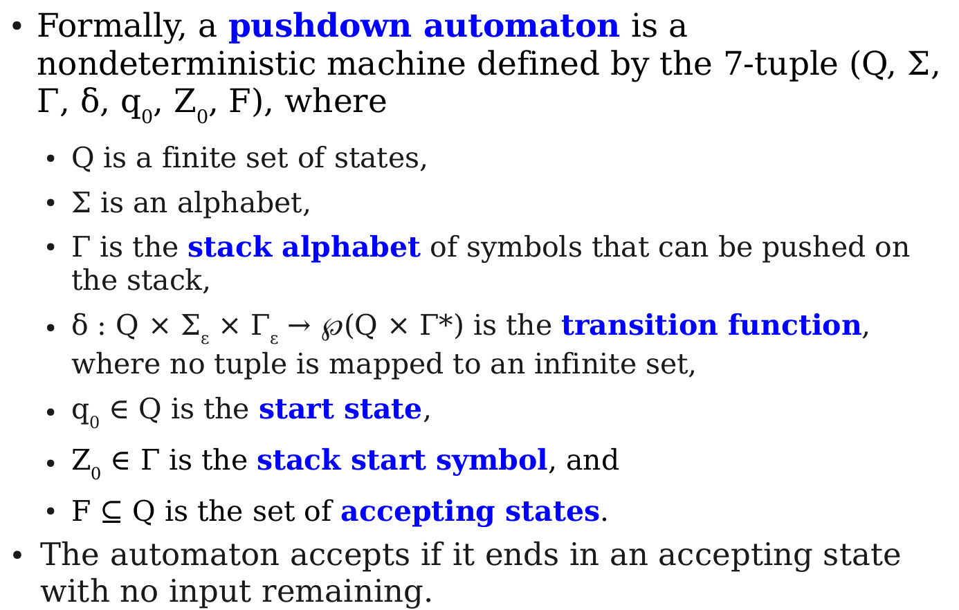
Formal Definition NPDA
next slide
Notes:
62
highlight delta , complicated , next slide
and the acceptance condition
others are possible, again basically equivalent

Slide 63
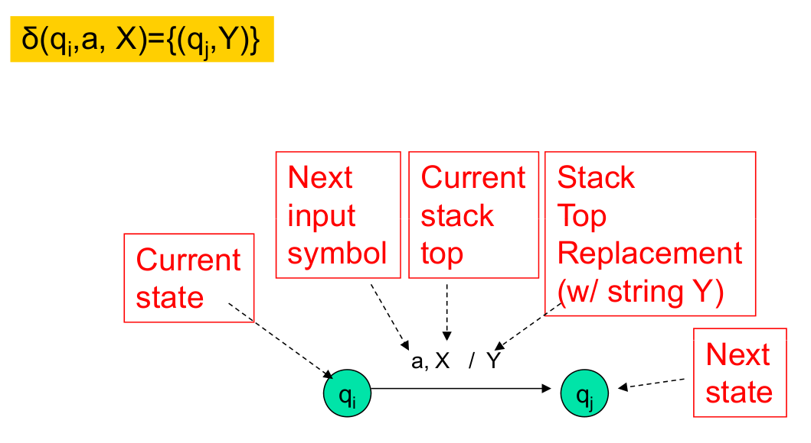
Transitions (not a simple table any more)
Non-determinism! {} possible, too
Notes:
63

Slide 64
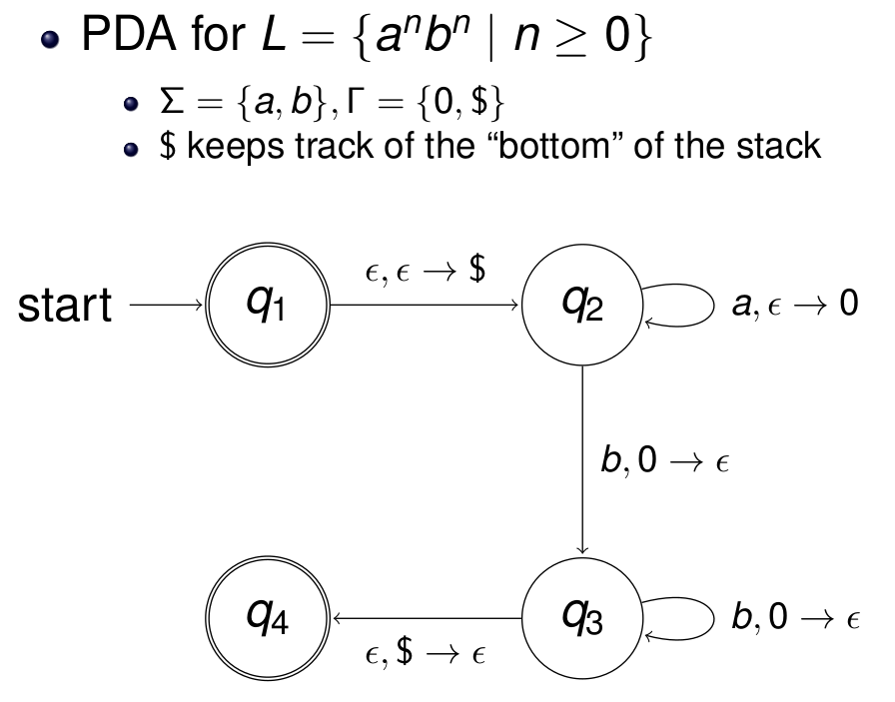
NPDA for a^{n}b^{n}
Notes:
64

Slide 65
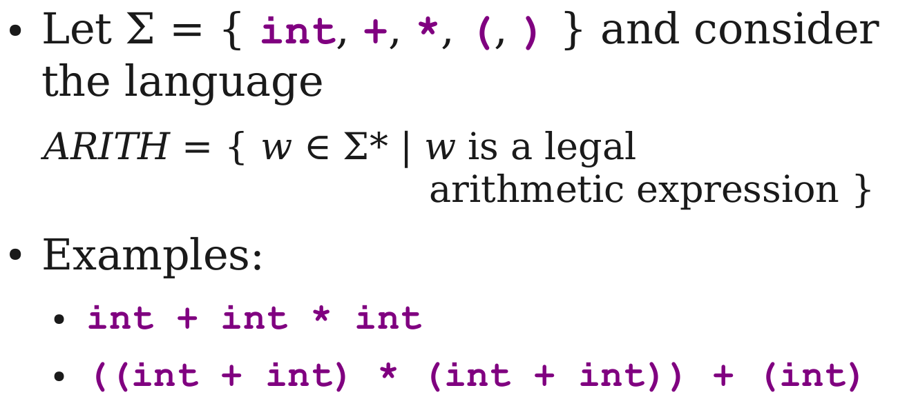
Another Example: Arithmetics
Notes:
65
somewhat swimming here

Slide 66
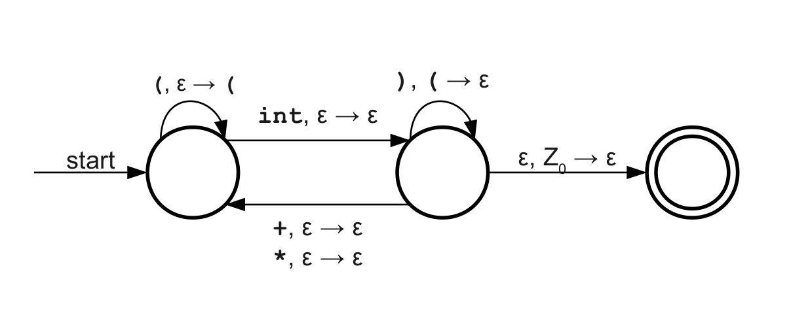
NPDA for ARITHM
Notes:
66
make sure you can explain this !!
int
Here it's assumed that Z0 is already on the stack
(int) ((((int))))
int + ( ARITHM )
(int) + (ARITHM)
(ARITHM) + (ARITHM)
q1 pops ( q2 resolves them
if a mismatch occurs at some point the machine dies
can go from q2 to q3 if Z0 permits but if that is done too early, the machine dies → determinism .. the machines get cloned all the time

Slide 67
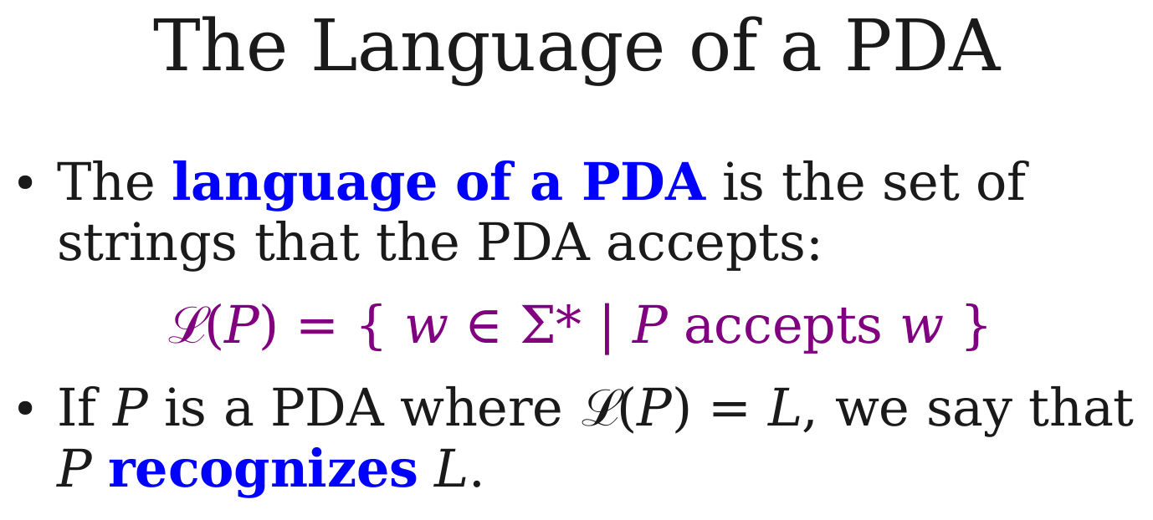
Notes:
67

Slide 68
It can be shown that Non-Deterministic PDAs compute (i.e. recognise) exactly the context free languages.
Notes:
68

Slide 69
What does this all mean for Computing?
A Program is a “word” of a CFL (C/C++/Java...)
A Parser uses a CFL to construct a syntax tree
A Compiler uses the syntax tree (plus context-sensitive constraints) to generate code for the Program that can be directly executed on a machine
Notes:
69

Slide 70
What does this all mean for Computing?
A Program is a “word” of a CFL (C/C++/Java...)
A Parser uses a CFL to construct a syntax tree
A Compiler uses the syntax tree (plus context-sensitive constraints) to generate code for the Program that can be directly executed on a machine
Execution may use a (Deterministic) PDA, but usually virtual or real machines that execute code are more complicated (Random Access Machine, von Neumann Architecture, Harvard Architecture,..)
Notes:
70

Slide 71
Final Comments
Notes:
71

Slide 72
Beyond Context-Free Grammars
In regular and context-free languages the left hand side of a production is always a single syntactic variable
More generally this could indeed be any finite, non-empty string of variables and terminals
aBc → uVwXy
This leads to Context-sensitive Languages if the strings never get shorter under a rule …
.. and to Phrase-Structure Grammars if they can shrink, e.g., aBc → uV
Notes:
72

Slide 73
Chomsky Hierarchy
phrase-structure
English
context-sensitive
a^{n}b^{n}c^{n}
C/C++/Java
context-free
a^{n}b^{n}
a^{n}b^{n}
regular
a*
Regular, context-free, context-sensitive and phrase-structure languages form a hierarchy by proper set inclusion, the Chomsky Hierarchy
Notes:
73

Slide 74
Turing Machines
Context-sensitive and phrase-structure languages can be recognised by Turing machines
A Turing machine is basically an NFA with a two sided tape (which can be made of two stacks).
More tapes do not increase the power.
The Turing machine can compute “everything” that is computable with discrete states.
Another lecture/module → Turing machines
Notes:
74

Slide 75
Summary
RegExps are truly useful in programming
Formal languages and grammars are truly useful to understand what computers can do
RegExps, DFAs, NFAs & regular grammars all exactly correspond with regular languages
Context-free grammars exactly correspond with Non-Deterministic Pushdown Automata
Formal Languages form the Chomsky Hierarchy
Notes:
75

